Slide 1
EDIBLE vs POISONOUS
MUSHROOMS
Applied Linear Regression II
Austin Abraham

Slide 2
TABLE OF CONTENTS
01
02
03
04
05
06
PURPOSE &
OBJECTIVES
DATASET DESCRIPTION
EXPLORATORY
DATA ANALYSIS
MODEL BUILDING
MODEL EVALUATION
CONCLUSION

Slide 3
01
PURPOSE & OBJECTIVES

Slide 4
PURPOSE
Distinguish between edible and poisonous mushrooms is a critical issue for foragers, chefs, and public health officials. Misidentification can lead to serious health risks, yet visual inspection remains one of the most accessible methods for classification to this day.
This project uses a detailed mushroom dataset from Kaggle to develop a logistic regression model that predicts whether a mushroom is edible or poisonous based on its physical characteristics and ecological traits.
With over 61,000 observations, the dataset offers a rich source for statistical modeling. By identifying which features are most predictive of edibility, we aim to build an interpretable and actionable model that could support safer mushroom identification and broader understanding of fungal biology

Slide 5
OBJECTIVES
To develop a binary classification model that predicts whether a mushroom is edible (e) or poisonous (p) based on a variety of attributes related to morphology (cap, stem, gills), environment (habitat, season), and other physical traits. We will:
Apply logistic regression to model the probability of a mushroom being poisonous
Determine which characteristics have the strongest influence on classification
Evaluate the model’s predictive accuracy using appropriate classification metrics

Slide 6
02
DATASET
DESCRIPTION

Slide 7
DATASET
61,069
OBSERVATIONS
each representing a unique mushroom sample
class
TARGET VARIABLE
Binary indicator of mushroom edibility
p = poisonous
e = edible
21
VARIABLES
describe its physical features and natural growing conditions

Slide 8
DATASET
cap-diameter (numeric): Diameter of the mushroom cap in centimeters
cap-shape: Shape of the cap (e.g., bell, convex, flat, sunken)
cap-surface: Texture of the cap (e.g., fibrous, smooth, scaly, sticky)
cap-color: Color of the cap (e.g., brown, red, white, yellow)
does-bruise-or-bleed: Indicates whether the mushroom bruises or bleeds when damaged
gill-attachment: Describes how the gills are attached to the stem
gill-spacing: Spacing between the gills (e.g., close, distant)
gill-color: Color of the gills
stem-height (numeric): Height of the mushroom stem in centimeters
stem-width (numeric): Width of the stem in millimeters
stem-root: Structure of the stem’s base (e.g., bulbous, cup-shaped, rhizomorphs)
stem-surface: Texture of the stem surface (e.g., smooth, silky, grooved)
stem-color: Color of the stem
veil-type: Type of veil covering the gills (partial or universal)
veil-color: Color of the veil
has-ring: Whether the mushroom has a ring around the stem
ring-type: Type of ring present (e.g., pendant, flaring, grooved, scaly)
spore-print-color: Color left by the mushroom's spore print
habitat: Type of environment the mushroom grows in (e.g., woods, meadows, urban)
season: The season when the mushroom is observed (spring, summer, autumn, winter)

Slide 9
03
EXPLORATORY DATA ANALYSIS

Slide 10
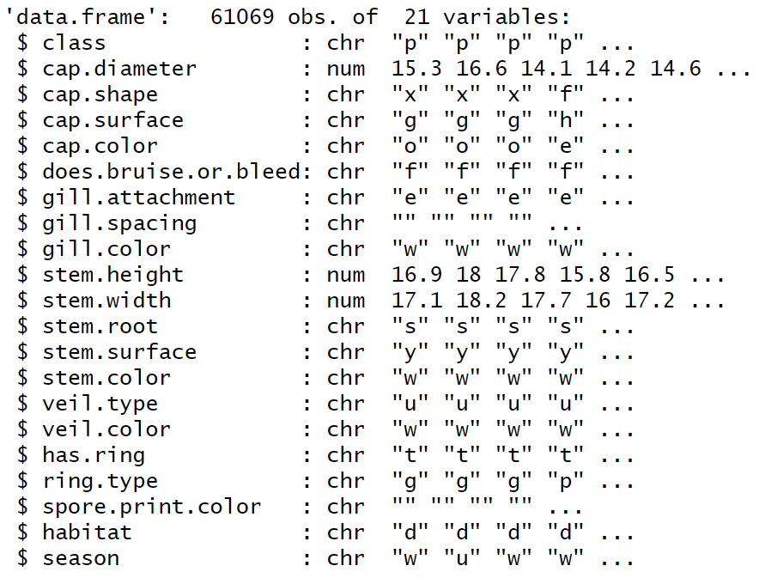
STRUCTURE OF DATASET
NUMERIC: 3
Cap diameter, stem height & stem width
CATEGORICAL: 18
Cap diameter, stem height & stem width
mix of attribute types makes the dataset highly suitable for a logistic regression classification model
Notes:
We started by looking at the structure of the dataset
TOTAL OF 61069 OBSERVATIONS AND 21 VARIABLES (3 of which are numeric and 18 categorical).
The combination of numerical and categorical features allows logistic regression to effectively capture both, linear trends and category-driven patterns in a binary classification problem.
MAKES IT A GREAT dataset
We chose it because:
• It’s a binary classification problem (edible vs. poisonous) — perfect for logistic regression.
• It has many categorical predictors, which are well-suited to the logistic regression model after the factor conversion.
• It allows us to practice:
• Fixing missing categorical data
• Feature selection with AIC/BIC
• Model validation with train/test splits
• Interpreting coefficients for business insights

Slide 11
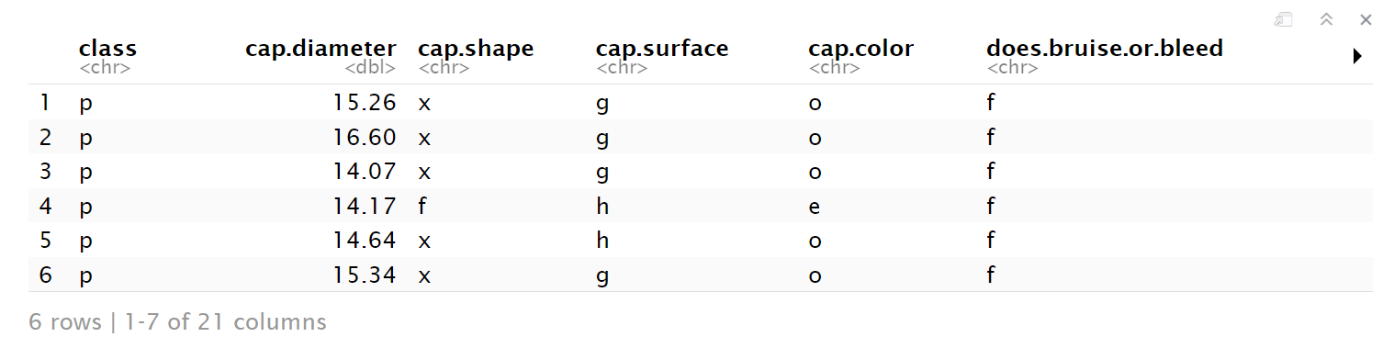
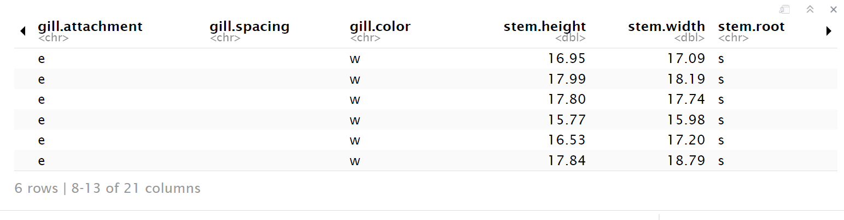
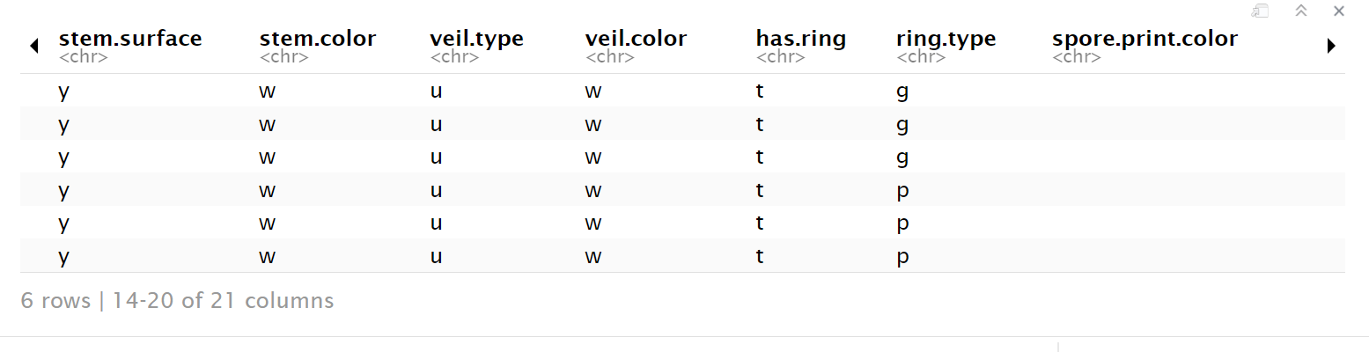
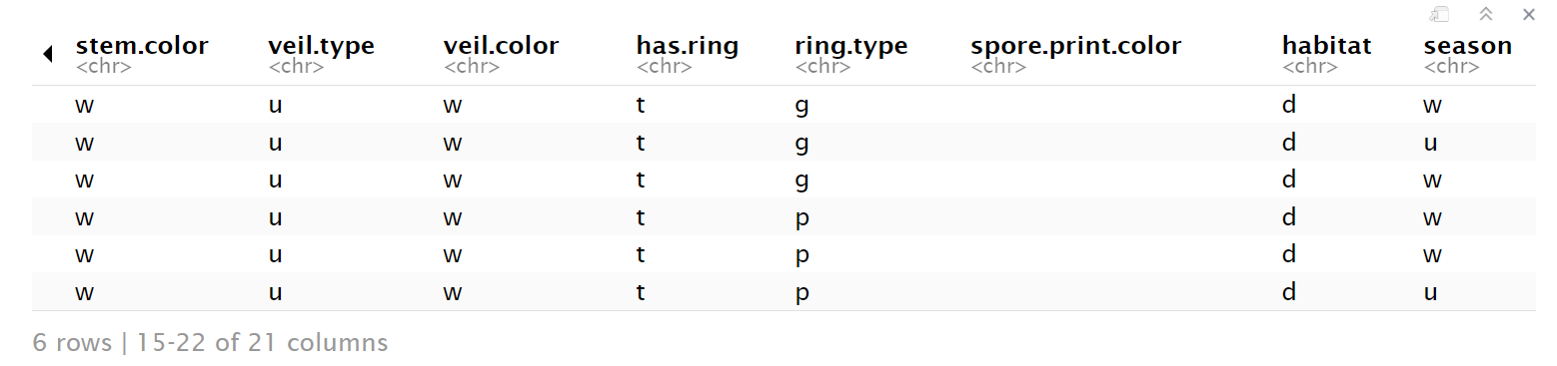
FIRST ROWS
Notes:
BY looking at the first few rows we became more comfortable with the data and can also immediately see that theres some columns with no data such as gill.spacing and spore print color .. .so we began our data cleaning process

Slide 12
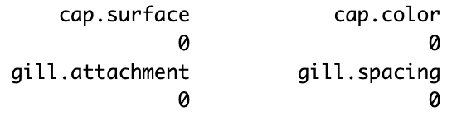
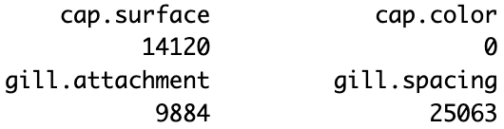
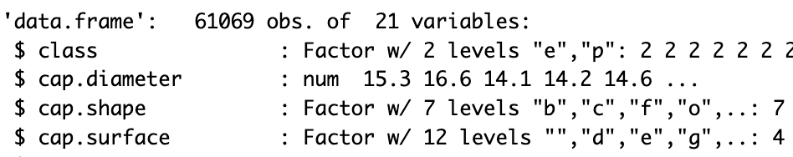
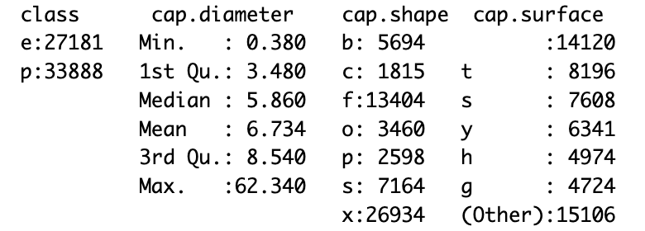
NULL VALUES
CONVERT CHR TO FACTORS
OUTLIERS
DATA CLEANING
Replace blank strings with NA in factor columns
Columns with more than 80% missing values were dropped (-4 variables)
Missing values (like in cap.surface) were imputed using the most frequent category (mode)
Numerical features have potential outliers and need to be scaled and check for skewness before modeling
Notes:
We checked for null values and there werent any, so we had to check for blank spaces, and then replaced blank strings with NAs in factor columns.
Then we removed nulls again and it was clean.
We also dropped columns with more than 80% of missing values, where we dropped a total of 4 variables.
And used the mode or most frequent level to replace missing values.
DUring this process we also converted characters to factors to transform the categorical variables into dummies and can see the number of levels and frequency
And finally, during this process we also saw a big spread in the data which is important to consider in our analysis.
Check for null: colSums(is.na(d))
# Replace blank strings "" with NA in factor columns
d[] <- lapply(d, function(x) {
if (is.character(x) || is.factor(x)) {
x <- as.character(x)
x[x == ""] <- NA
return(as.factor(x))
} else {
return(x)
}
})
Then dropped columns with more than 80% of missing values
# Drop columns with more than 80% missing values
threshold <- 0.8 * nrow(d)
d <- d[, colSums(is.na(d)) <= threshold]
# Impute with most common level (MODE / FREQUENCY)
mode_cap_surface <- names(sort(table(d$cap.surface), decreasing = TRUE))[1]
d$cap.surface[is.na(d$cap.surface)] <- mode_cap_surface
## Convert all character columns to factors
d[sapply(d, is.character)] <- lapply(d[sapply(d, is.character)], factor)

Slide 13
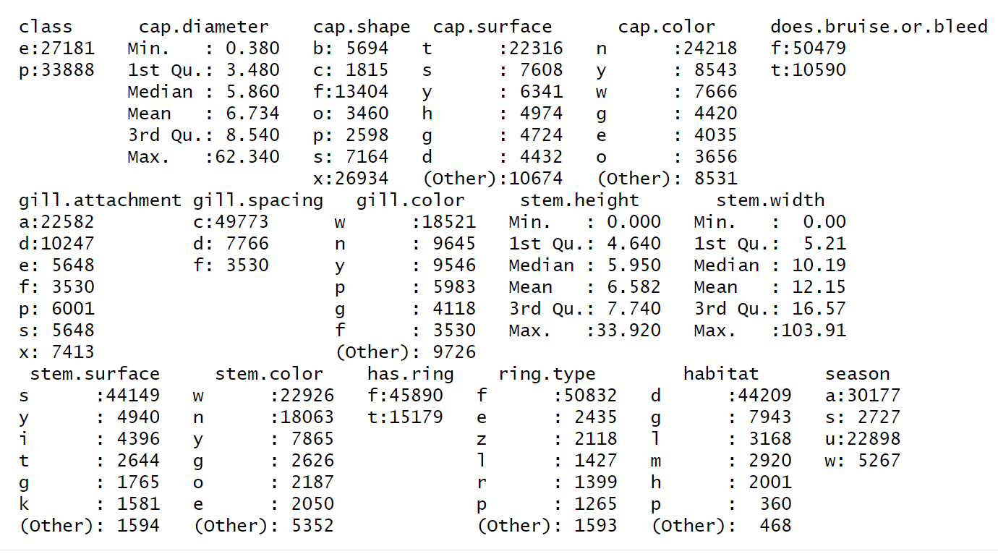
STATISTICAL SUMMARY
numerical variables summarized using descriptive statistics
unusual
value
DUAL-FORMAT SUMMARY
helps identify class imbalances, detect unusual values, and spot potential data quality issues (crucial steps before applying any machine learning models)
categorical variables broken down by frequency
Notes:
The statistical summary showed a dual format summary where categorical variables are broken down by frequency and numerical variables are summarized using descriptive statistics.
___-
🛠️ Solution: Standardizing or normalizing numerical variables (which you already did in your code!) ensures they contribute proportionally.

Slide 14
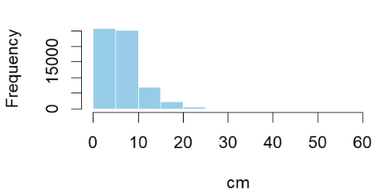
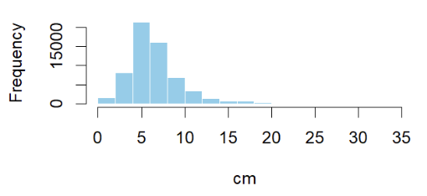
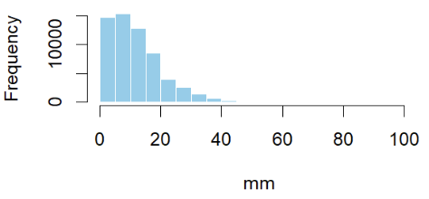
FREQUENCY DISTRIBUTION
key continuous features
right - skewed distributions:
CAP DIAMETER
STEM HEIGHT
STEM WIDTH
Most mushrooms are in the smaller end of “size”, but there are a few outliers with significantly larger dimensions
Notes:
Performed a frequency distribution of the numerical variables and can see that they are skewed to the right showing that most mushrooms are in the smaller end of size, but there are definitely some outliers that can pull the mean upwards.
In logistic regression, this can inflate coefficient magnitude and reduce interpretability
_________________
“Log-transforming these features might reduce skewness and better align with model assumptions.”
cap.diameter and stem.height are in cm, but stem.width is in mm — this introduces an unbalanced scale across features.

Slide 15
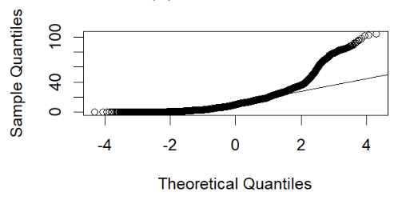
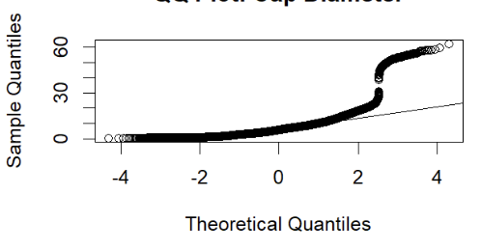
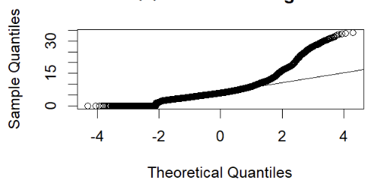
CHECK FOR NORMALITY
QQ PLOTS
not normal distributions:
CAP DIAMETER
STEM HEIGHT
STEM WIDTH
All three variables show noticeable deviations from the straight line, particularly at the tails, but logistic regression doesn’t require normal predictors
Notes:
When we checked for normality we saw that this data is not normally distributed as the tail bends away from the reference line, and this confirms that the data is right-skewed and includes some outliers, however this does not affect the validity of our model since logistic regression is a generalized linear model, and predictors don’t need to be normally distributed.
The fact that the points bend away from the diagonal line, especially in the tails, confirms that the data:
Are right-skewed
Include outliers or extreme values
Deviate significantly from normality
Logistic regression doesn’t require normal predictors
This is not a problem for the validity of your model — logistic regression is a generalized linear model, so predictors don’t need to be normally distributed.
You're not violating any assumptions — but…
2. But skewed distributions affect interpretation
Extreme skewness and large values may:
Cause coefficient instability
Lead to inflated standard errors
Make your model less robust to new data
3. Transformations could improve model quality
A log transformation or standardization could:
Reduce skewness
Improve numerical stability
Make coefficients easier to interpret
MAYBE JUST SAY THIS:
"Although logistic regression does not require normal predictors, the clear deviations from normality—especially in stem.width—suggest that data transformation (e.g., log or z-score scaling) could improve model performance and interpretation in future work."

Slide 16
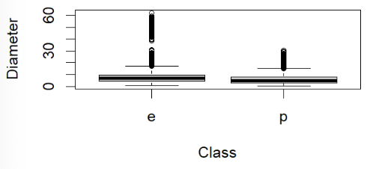
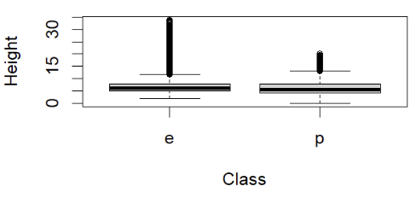
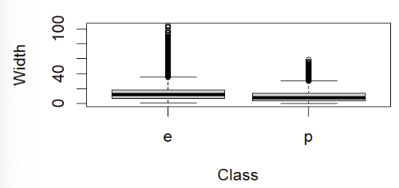
PAIRWISE RELATIONSHIP
BOX PLOTS
difference in distribution of edible (e) and poisonous (p) classes:
CAP DIAMETER
STEM HEIGHT
STEM WIDTH
Medians between “e” and “p” are similar, but distributions differ
Notes:
Finally, these box plots compare edible vs poisonous mushrooms for each numerical variable. “Although medians between edible and poisonous mushrooms are similar, greater variance in the edible group — especially in cap diameter and stem width — which may actually help the model separate the classes better.
“Mean values don’t differ much, but variance and extremes may help the model separate the classes.”
“Edible mushrooms have a wider range of shapes and sizes, which could affect model generalizability.”
3. Skew and tails may help classification
While overlapping, the differences in distribution tails might still provide predictive signal for logistic regression.
Consider: “The model may pick up on subtle tail differences even when median values align.”
SUMMARY:
“Although medians between edible and poisonous mushrooms are similar, greater variance and more extreme outliers in the edible group — especially in cap diameter and stem width — may still provide useful signal for classification.”

Slide 17
04
MODEL BUILDING &
SELECTION

Slide 18


LOGISTIC REGRESSION MODELS
FITTED IN TRAINING DATA
1.
2.
3.
BASELINE MODEL
STEPWISE MODEL (AIC)
BACKWARDS MODEL (BIC)
glm(formula = class ~ ., family = "binomial", data = d)
Large number of noisy variables
16 predictors
Most dominant predictors of edibles
(high z-value, low p-value):
Stem surface “g” (strong positive)
Cap shape “x” (strong negative)
Cap.shape “s” (strong negative)
glm(class ~ cap.diameter+cap.shape +cap.surface+cap.color+gill.attachment+gill.spacing+gill.color+stem.height+stem.surface+stem.color+has.ring+ring.type+habitat+season+stem.width, family = "binomial", data = d)
Reduced model complexity without hurting performance
15 predictors
Most dominant predictors of edibles:
(high z-value, low p-value):
Cap surface “k” (strong positive)
Cap surface “i” (strong positive)
Cap surface “e” (strong positive)
glm(formula = class ~ cap.diameter+cap.shape+cap.surface+cap.color+does.bruise.or.bleed+gill.attachment+gill.spacing+gill.color+stem.height+stem.surface+stem.color +has.ring+ring.type+habitat+season, family = "binomial", data = d)
Maintained model complexity and improved performance
15 predictors
Most dominant predictors of edibles:
(high z-value, low p-value):
Cap color “p” (strong positive)
Stem height (strong positive)
Gill color “y” (strong positive)
Notes:
Baseline model included too many noisy variables, so we moved to stepwise selection to simplify without losing performance.
Stepwise vs. Backwards (BIC): Both models use 15 predictors, but:
Stepwise includes stem.width
Backwards includes does.bruise.or.bleed instead
Example interpretations:
Cap color “p”: Strongly increases odds of being edible
Stem height: Taller mushrooms are more likely edible (numeric)
Stem surface “g”: Strong edible signal (possibly linked to gill traits)

Slide 19
COMPARISON OF MODELS
BACKWARDS MODEL IS LEANER, MORE ACCURATE AND MORE INTERPRETABLE THAN THE ORIGINAL MODEL
Key Classification Metrics | BASELINE MODEL | STEPWISE MODEL (AIC) | BACKWARDS MODEL (BIC)
# of Predictors | 21 | 15 | 15
Accuracy | 80.18% | 81.14% | 81.20%
Sensitivity (edible detection) | 81.08% | 80.97% | 81.22%
Specificity (poison detection) | 79.47% | 81.28% | 81.19%
AUC (discriminatory power) | 86.77% | 88.35% | 88.35%
Kappa (agreement) | .6015 (moderate) | 0.6198 (good) | 0.6212 (good)
detect poisonous mushrooms and avoid misclassifying them as edible!
Notes:
Sensitivity = correctly identifying edible mushrooms
What's at Stake?
False negative = Predict poisonous, but it's actually edible (inconvenient but safe)
False positive = Predict edible, but it's actually poisonous ( Very dangerous)
Specificity = correctly identifying poisonous mushrooms
You must correctly detect the poisonous mushrooms to avoid misclassifying them as edible. There is a very slight difference between stepwise and backwards, so it still makes sense to use backwards as it is overall slightly better.
So backwards model is likely safest as it has an overall high detection in predicting edible and poisonous mushrooms.
_______________________
“While both the AIC-based stepwise model and the BIC-based backward selection model perform nearly identically in terms of overall accuracy and AUC (both at 0.8835), the BIC model is slightly more favorable. It uses fewer variables, has a marginally higher Kappa statistic and precision, and maintains a comparable balance between sensitivity and specificity. Given its simplicity and comparable performance, the BIC model is preferred as the final model.”

Slide 20
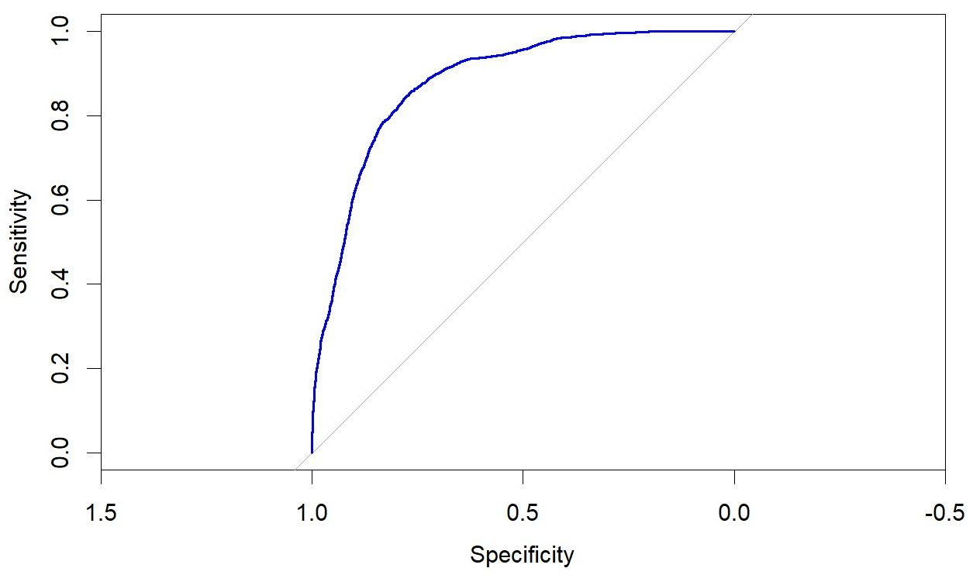
FINAL MODEL SELECTION: BIC
TRAIN-TEST-SPLIT ( 80/20)
STEPS
Create a train/test split (train_index, train_data, test_data)
Set correct class levels so “e” is the positive class
Fit full model (full_model)
Fit backward selection model using BIC (step_bic)
Predict test data
Classify test data (edible if prob > 0.5)
Evaluate using confusion Matrix
ROC & AUC
Evaluation (next slide!)
AUC: 88.08%
Notes:
Here, we walk through how we finalized the BIC model using a train-test split.
We split the data 80/20, trained the full logistic model, and applied backward selection with BIC.
We then predicted and classified the test set, evaluated it using a confusion matrix, and plotted the ROC.
The result was a strong AUC of 88.08%, showing good discriminatory power between edible and poisonous mushrooms.

Slide 21
05
FINAL MODEL EVALUATION

Slide 22

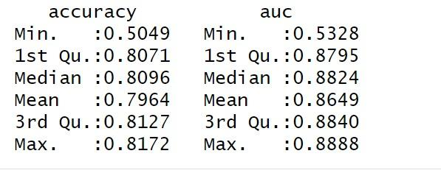
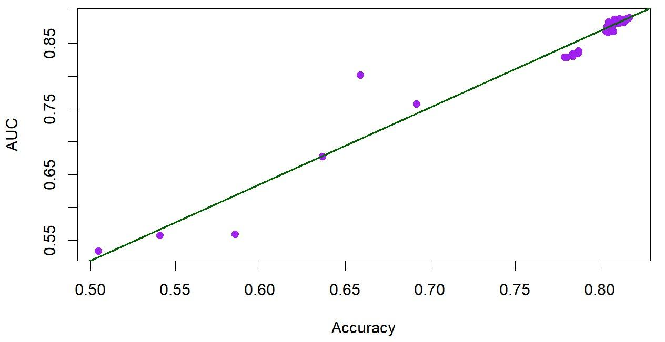
RESULTS
100 ITERATIONS
Consistent high performance
Stable across random train-test splits
Values are tightly clustered between 1st and 3rd quartile
Strong median performance
AUC > Accuracy
Captures ranking performance better than classification accuracy ( avoid false negatives like classifying poisonous as edible)
Linear relationship
As accuracy improves, the model becomes better at distinguishing between “p” and “e”
Outliers: room for improvement
Accuracy: 50.49%
AUC: 53.38%
Accuracy vs AUC
*Saved results from 100 iterations as a separate .csv
Notes:
To ensure our model wasn’t just performing well by chance, we ran it 100 times — each time with a new random 80/20 train-test split.
What we saw was stable performance: accuracy stayed tightly between about 0.807 and 0.817 for most runs, and AUC was even more consistent, clustering between 0.879 and 0.884.
That tight clustering tells us our model isn’t just occasionally good — it’s reliably strong no matter how the data is split.
Median values look great too — we’re getting an accuracy near 81%, and an AUC over 88%, which means the model isn't just classifying well, but also ranking edible vs. poisonous mushrooms really effectively.
And you can see from the scatterplot that as accuracy increases, AUC goes up too — so better classification goes hand-in-hand with better discrimination.
We do see a few lower outliers — mostly from random splits that didn’t play nicely — but overall, this is the kind of stability you want to see in a production-ready model.
1️⃣ High Consistency in Performance
Most accuracy values are tightly clustered between ~0.807 and 0.817 (1st to 3rd quartile).
Similarly, AUC values are very concentrated between 0.879 and 0.884.
This tight range shows the model performs very consistently across different data splits.
2️⃣ Strong Median Performance
Median Accuracy: 0.8096
Median AUC: 0.8824
The model is reliably accurate and has excellent discrimination power (ability to rank poisonous vs edible).
3️⃣ AUC > Accuracy
Across nearly all iterations, AUC is consistently higher than accuracy, indicating the model captures ranking performance better than just classification accuracy.
This is especially important when class thresholds vary or when avoiding false negatives (like classifying poisonous as edible) is critical.
4️⃣ Linear Relationship
The scatterplot shows a strong positive correlation between AUC and Accuracy.
Indicates that as the model becomes more accurate, it also becomes better at distinguishing between classes.
5️⃣ Few Outliers
A small number of points fall significantly below the main cluster (e.g., accuracy ~0.50–0.65), suggesting rare poor performances in a few iterations — potentially from unlucky splits or sampling noise.

Slide 23

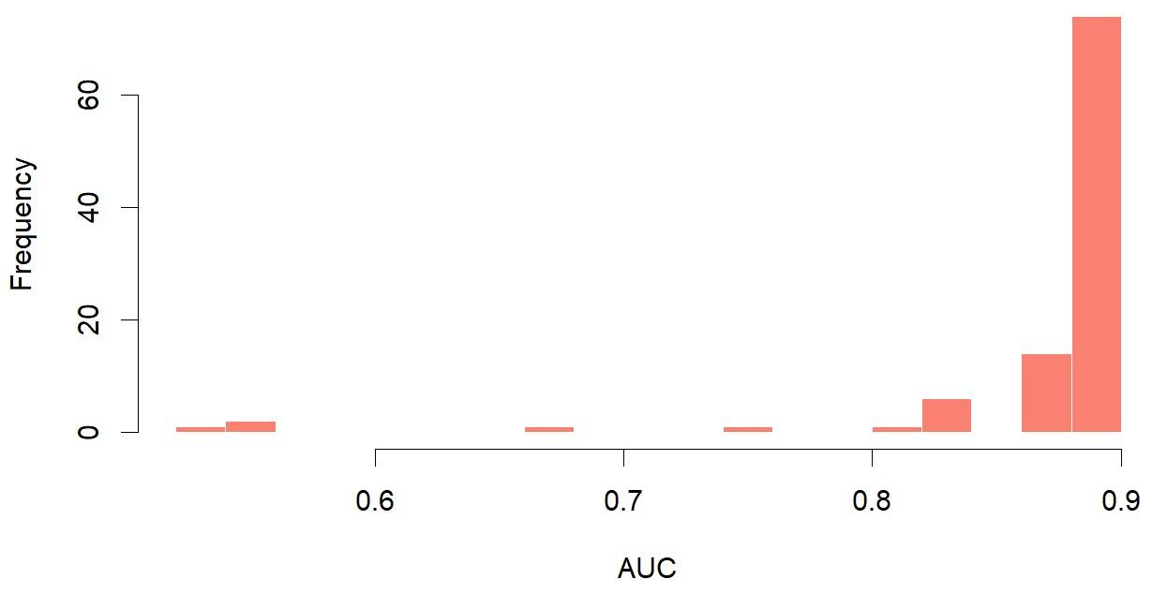
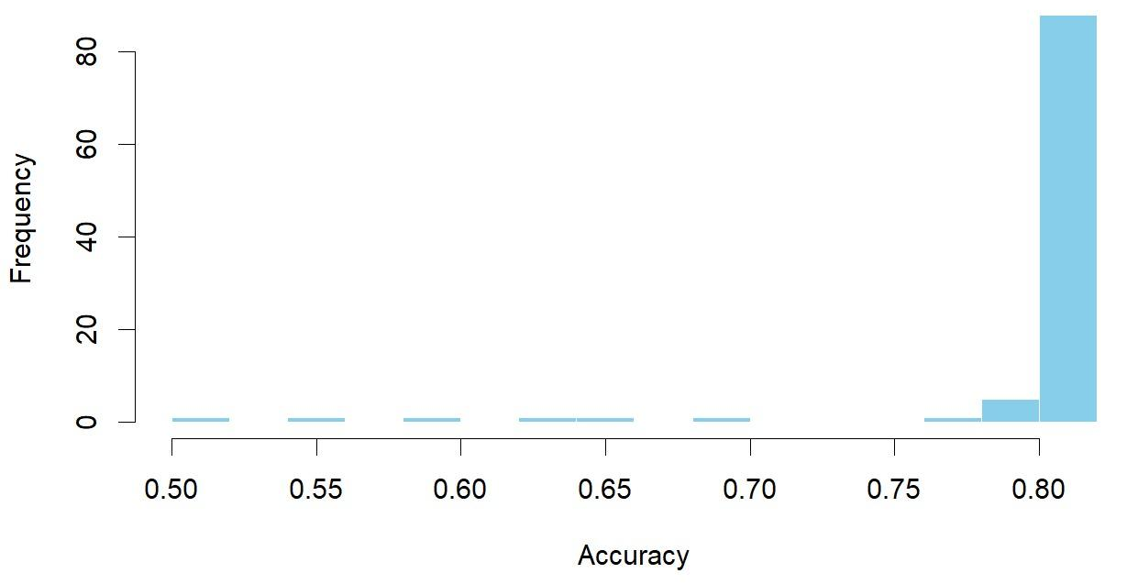
ROBUST & RELIABLE
Distribution of AUC
70+ out of 100 runs fall between 88-89%
90+ out of 100 runs ran with 80%+ AUC
Model is great at distinguishing edible from poisonous mushrooms
Outliers are likely due to unfavorable train-test splits
Distribution of Accuracy
80+ out of 100 runs had accuracy between 80-81%
Model is stable and consistent
Few runs fall below 75% accuracy
Notes:
Now that we’ve seen our model performs well, the key question is — is it reliable?
First, looking at accuracy on the bottom left — more than 80% of our 100 runs landed between 80 and 81%. That’s super tight clustering, and it tells us our model is stable across random splits.
On the top right, we see AUC results — again, really strong. Over 70 runs hit between 88% and 89%, which shows the model is great at separating edibles from poisonous mushrooms.
There are a few outliers — like accuracy or AUC dropping closer to 50 or 60% — but those are probably just from unlucky train/test splits.
Bottom line: our model isn’t just good — it’s robust and dependable, no matter how you slice the data.
1. Accuracy Distribution (Bottom Left)
Over 80 out of 100 runs had accuracy clustered tightly around 0.80–0.81
This confirms the model is highly stable and consistent
Only a few runs fall below 0.75, showing minimal performance degradation under different splits
🔹 2. AUC Distribution (Top Right)
AUC is consistently very high, with most runs falling between 0.88 and 0.89
AUC values below 0.8 are rare — this reflects the model's excellent ability to distinguish edible from poisonous mushrooms
🔹 3. Rare Outliers
A small number of runs had lower accuracy (~0.5–0.7) or AUC (~0.6), likely due to unfavorable train-test splits, but these are exceptions
🔹 4. Final Message
Together, these plots show the model is not just high-performing — it's robust, reliable, and generalizes well across data partitions

Slide 24
06
CONCLUSION

Slide 25
CONCLUSION
Our objective to develop a binary classification model that predicts whether a mushroom is edible (e) or poisonous (p) based on a variety of attributes was successfully met
Logistic regression was applied
Key predictors were identified
Used backward selection and BIC to achieve a reliable and generalizable predictive model
AUC: 88%*
Accuracy: 81%*
*medians
Notes:
To wrap up — our goal was to build a model that could accurately classify mushrooms as edible or poisonous based on their physical and environmental features.
We applied logistic regression and used backward selection with BIC to refine the model. The result? A lean, interpretable, and reliable classifier.
Over 100 runs, our final model achieved a median AUC of 88% and accuracy around 81%, showing strong and consistent predictive performance.
Some of the most influential predictors included cap color "p", stem height, and gill color "y". These features consistently helped differentiate edible mushrooms from dangerous ones.
Compared to the baseline and AIC-based models, our BIC-selected model offered the best trade-off between performance and simplicity.
Bottom line — this model isn’t just statistically sound. It’s also practical — with potential applications in food safety, education, and public health.
Conclusion
🔹 A reliable and interpretable model
The final logistic regression model selected using BIC effectively predicts whether a mushroom is edible or poisonous based on physical and environmental traits.
🔹 Strong and consistent performance
Across 100 iterations, the model achieved a median AUC of 88.1% and accuracy above 80%, demonstrating high and stable predictive power.
🔹 Key features drive prediction
Variables such as cap color “p”, stem height, and gill color “y” were among the most influential predictors of edibility.
🔹 Backward model is preferred
The BIC-selected model offered a balance of high accuracy, interpretability, and reduced complexity, outperforming the baseline and stepwise alternatives.
🔹 Robust model with practical value
The model not only generalizes well but also supports safer decision-making, with implications for public health, education, and food safety awareness.
✅ Conclusion
🔹 Logistic regression successfully applied
We developed a binary classification model using logistic regression to predict mushroom edibility. The model used physical and environmental attributes — including cap shape, stem height, and gill color — to distinguish between edible and poisonous mushrooms.
🔹 Key predictors identified
The most influential characteristics for predicting edibility included:
Cap color “p” (strong edible indicator)
Stem height (positive association with edibility)
Gill color “y” (strong edible predictor) These variables consistently showed high significance across models.
🔹 Strong and stable predictive performance
Using backward selection and BIC, our final model achieved:
Median AUC ~88%
Median Accuracy ~81% These metrics remained stable over 100 random train-test splits, confirming the model’s reliability and generalizability.
Final reflection
We met our objectives by building a well-performing and interpretable model that effectively classifies mushrooms and reveals the traits most critical for safe identification.

Slide 26

THANKS
DO YOU HAVE ANY QUESTIONS?
Notes:
Type of cross val we did
Monte Carlo cross-validation
Accuracy of Log when used for the numeric variables and then fitting a bic model.
Accuracy : 0.8091
The log-transformed model does not provide any performance boost.
Accuracy, AUC, and Kappa are slightly lower or the same compared to the original.
This suggests log transformation wasn’t beneficial for our dataset.
Likely reason: the numeric variables (e.g., cap.diameter, stem.height) are already reasonably well-behaved and don’t show strong skew or heteroscedasticity, so transforming didn’t help.
Metric | One-Time BIC Model | Log-Transformed BIC Model
Accuracy | 0.8113 | 0.8091
AUC | 0.8835 | 0.8786
Kappa | 0.6222 | 0.6152
Sensitivity (Edible) | 0.8134 | 0.8085
Specificity (Poisonous) | 0.8090 | 0.8095
Balanced Accuracy | 0.8112 | 0.8090
PPV (Precision for Edible) | 0.7786 | 0.7729
NPV (Precision for Poisonous) | 0.8450 | 0.8405
The original BIC model slightly outperforms the log-transformed model across almost all metrics — including accuracy, AUC, and Kappa.
Log transformation didn’t offer improvement — likely because the numeric variables (like cap.diameter or stem.height) were already reasonably behaved and didn’t exhibit strong skew.
This confirms that log transformation wasn’t necessary in this case.

